Slide 1
CS212-Object Oriented Programming
Lecture 10
Abstract Classes and Interfaces
Study with Chapter 13 of Course Book

Slide 2
Abstract Classes
A class that is declared with abstract keyword, is known as abstract class in Java.
It can have abstract and non-abstract methods (method with body). For example:
public abstract class Shape {
// Abstract method without definition
public abstract void Draw();
public void Display() {
System.out.println(
"Display Method of Shape class");
}
}

Slide 3
Abstraction in Java
Abstraction is a process of hiding the implementation details and showing only functionality to the user.
Another way, it shows only important things to the user and hides the internal details.
Abstraction lets you focus on what the object does instead of how it does it.
There are two ways to achieve abstraction in Java:-
Abstract class (0 to 100%)
Interface (100%)

Slide 4
Abstract Classes
A class must be declared abstract if any of the following condition is true:-
The class has one or more abstract methods.
The class inherits one or more abstract methods for which it does not provide implementation.
The class declares that it implements an interface but does not provide implementation for every method of that interface.
An abstract class cannot be instantiated
Abstract classes defer the implementation to subclasses.
The subclass must provide the implementation of the abstract method or declare itself to be abstract in which case the implementation is deferred once again.
You can declare a variable/reference of an abstract class.
Notes:
abstract class Foo {
// .....
public abstract void foobar();
}
class Bar : Foo {
// .....
public override void foobar() {
// ....
}
}
Foo invalidReference = new Foo(); // cannot instantiate abstract class, error
Foo validReference = new Bar(); // valid
validReference.foobar(); // call common functionality, Bar.foobar() will be called

Slide 5
Abstract Classes
public abstract class LivingBeing {
public void breath() {
System.out.println(
"Living Being breathing...");
}
public void eat() {
System.out.println(
"Living Thing eating...");
}
public abstract void walk();
}
public class Human extends LivingBeing {
public void walk() {
System.out.println("Human walks...");
}
}

Slide 6
Abstract Classes
abstract class Shape {
abstract void draw();
}
class Rectangle extends Shape {
void draw() {
System.out.println("drawing rectangle");
}
}
class Circle extends Shape {
void draw() {
System.out.println("drawing circle");
}
}
class TestAbstraction {
public static void main(String[] args) {
Shape s = new Circle();
s.draw();
}
}

Slide 7
Abstract Classes
abstract class Shape {
abstract void draw();
}
class Rectangle extends Shape {
void draw() {
System.out.println("drawing rectangle");
}
}
class Circle extends Shape {
void draw() {
System.out.println("drawing circle");
}
}
class TestAbstraction {
public static void main(String[] args) {
Shape s = new Circle();
s.draw();
}
}
If you are extending any abstract class that has abstract method, you must either provide the implementation of the method or make this class abstract.

Slide 9
Abstract Classes
An abstract method cannot be contained in a non-abstract class.
If a subclass of an abstract superclass does not implement all the abstract methods, the subclass must be defined abstract.
In other words, in a non-abstract subclass extended from an abstract class, all the abstract methods must be implemented, even if they are not used in the subclass.
Object can’t be created from abstract class:-
An abstract class cannot be instantiated using the new operator, but you can still define its constructors, which are invoked in the constructors of its subclasses.
For instance, the constructors of GeometricObject are invoked in the Circle class and the Rectangle class.

Slide 10
Abstract Classes
abstract class Bike {
Bike() {
System.out.println("bike is created");
}
abstract void run();
void changeGear() {
System.out.println("gear changed");
}
}
class Honda extends Bike {
void run() {
System.out.println("running safely..");
}
}
class TestAbstraction {
public static void main(String[] args) {
Bike obj = new Honda();
obj.run();
obj.changeGear();
}
}

Slide 11
Abstract Classes
Abstract Class without Abstract Method
A class that contains abstract methods must be abstract.
However, it is possible to define an abstract class that contains no abstract methods.
In this case, you cannot create instances of the class using the new operator.
This class is used as a base class for defining a new subclass.
Superclass of Abstract Class may be Concrete
A subclass can be abstract even if its superclass is concrete.
For example, the Object class is concrete, but its subclasses, such as GeometricObject, may be abstract.

Slide 12
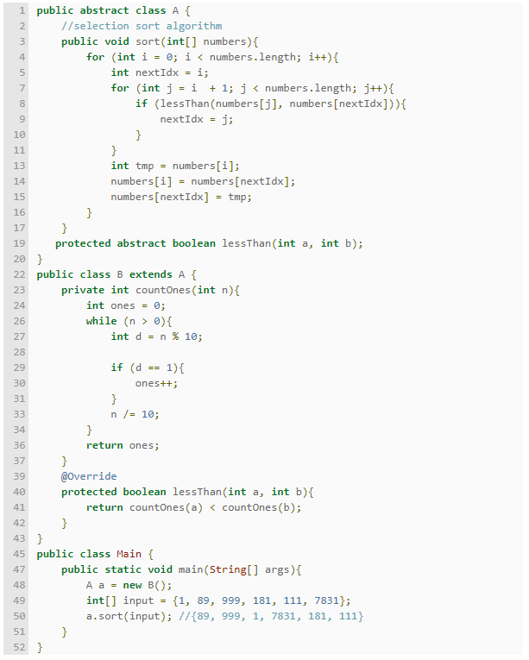

Slide 13
Interface
A superclass defines common properties and behavior for related subclasses (inheritance)
An interface defines common behavior for classes (including unrelated classes)
An interface is a collection of abstract methods. A class implements an interface, thereby inheriting the abstract methods of the interface.
An interface is not a class. Writing an interface is similar to writing a class, but they are two different concepts.
A class describes the attributes and behaviors of an object.
An interface defines behaviors (methods) that a non-abstract class is forced to implement.
No variables (except static, const) or method bodies.

Slide 14
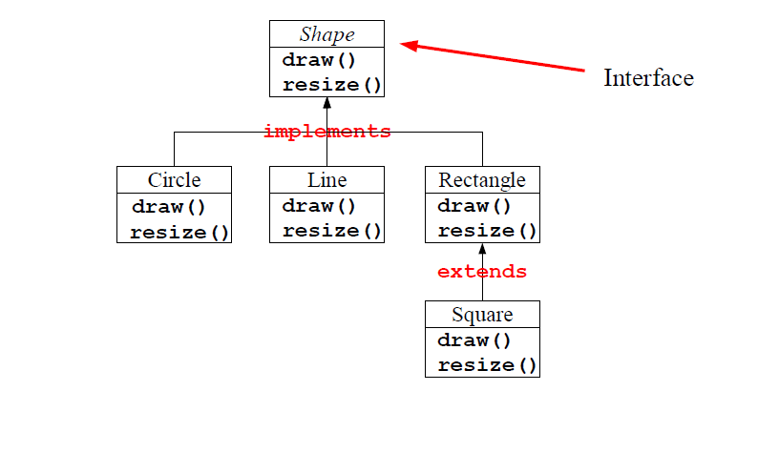
Interface
Unless the class that implements the interface is abstract, all the methods of the interface need to be defined in the class.

Slide 15
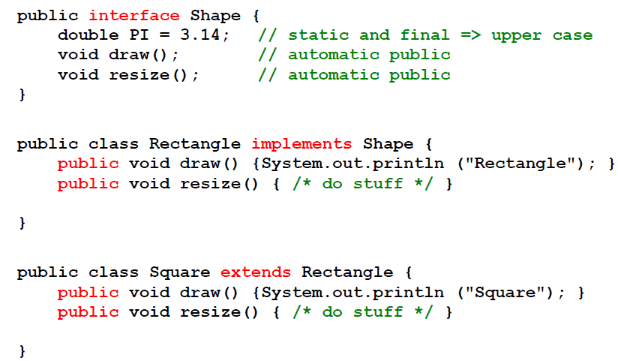
Interface

Slide 16
Interface
Type
An interface can be used as a type, like classes
A variable or parameter declared of an interface type is polymorph
Any object of a class that implements the interface can be referred by the Variable
Instantiation
Does not make sense on an interface.
Access modifiers
An interface can be public or “friendly” (the default).
All methods in an interface are default abstract and public.
Static, final, private, and protected cannot be used.
All variables (“constants”) are public static final by default
Private, protected cannot be used.

Slide 17
Interface
Interface as type in Java
interface I1 { }
interface I2 { }
class C implements I1, I2 { }
C c = new C();
boolean isC = (c instanceof C); //true
boolean isI1 = (c instanceof I1); //true
boolean isI2 = (c instanceof I2); //true
class B implements I1 { }
I1 i1 = new C(); i1 = new B();
i1 = new D(); ... class D extends C { }

Slide 18
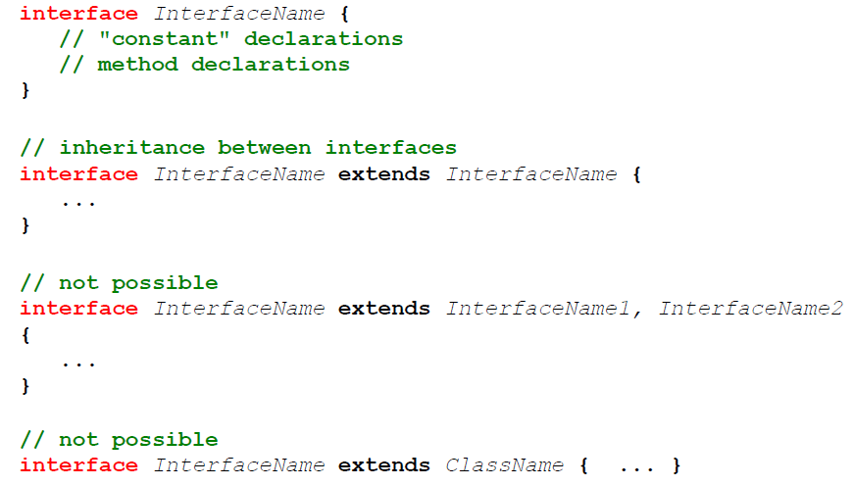
Interface
Interface can inherit multiple interfaces

Slide 19
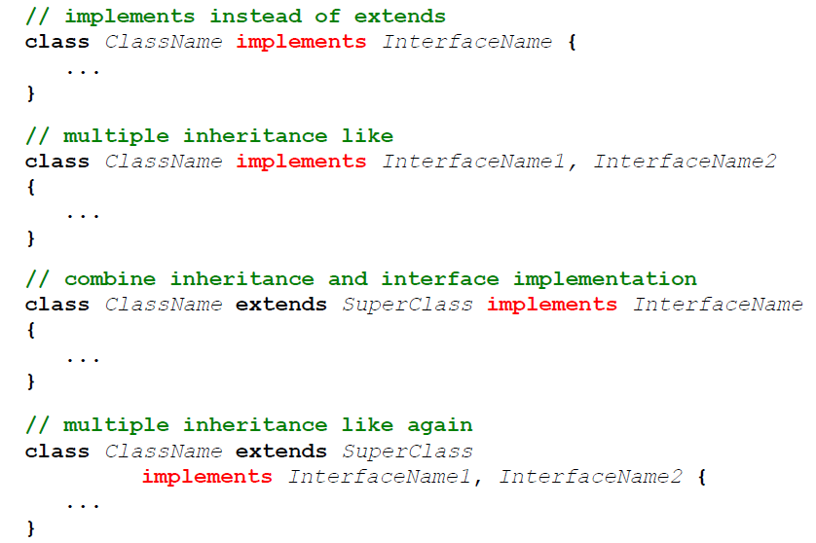
Interface

Slide 20
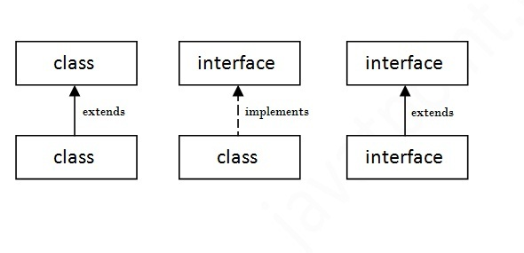
Interface
A class extends another class, an interface extends another interface but a class implements an interface.

Slide 21
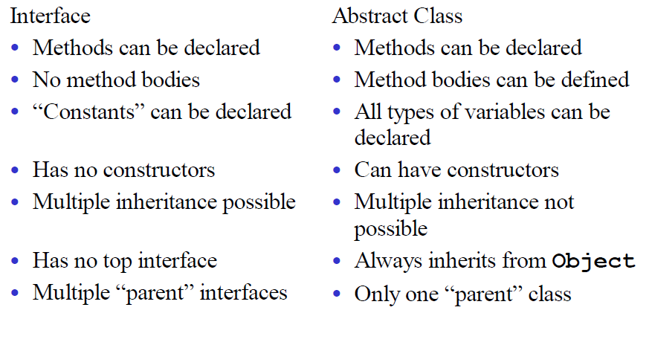
Interface

Slide 22
Interface
interface Animal {
public void eat();
public void travel();
}
public class Mammal implements Animal{
public void eat(){ System.out.println("Mammal eats"); }
public void travel(){ System.out.println("Mammal travels"); }
public int noOfLegs(){ return 0; }
public static void main(String args[]){
Mammal m = new Mammal();
m.eat();
m.travel();
}
}
When a class implements an interface, you can think of the class as signing a contract, agreeing to perform the specific behaviors of the interface. If a class does not perform all the behaviors of the interface, the class must declare itself as abstract.

Slide 23
Interface
interface Printable{
void print();
}
interface Showable{
void show();
}
class TestInterface implements Printable,Showable{
public void print(){ System.out.println("Hello");}
public void show(){ System.out.println("Welcome");}
public static void main(String args[]){
TestInterface obj = new TestInterface();
obj.print();
obj.show();
}
}

Slide 24
Interface
Summary
You cannot instantiate an interface.
An interface does not contain any constructors.
All of the methods in an interface are abstract.
An interface cannot contain instance fields. The only fields that can appear in an interface must be declared both static and final.
An interface is not extended by a class; it is implemented by a class.
An interface can extend multiple interfaces.

